Slide 1
Analysis on spotify songs
v.pallavi
214520
III B.Sc MSCS-2

Slide 2
CONTENTS
ABSTRACT
EXISTING SYSTEM
PROMPTS
FUTURE SCOPE
CONCLUSION

Slide 3

ABSTRACT
In this study, we delve into the world of songs available on Spotify app, one of India’s leading songs app. Our analysis focuses on several key aspects:
Danceability
Energy
Loudness
Popularity

Slide 4
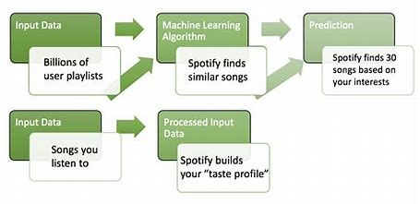
EXISTING SYSTEM

Slide 5
PROMPTS
Whether there is a relationship between numeric variables?
Analysis of the duration of the songs.
Whether there is a relation between mode and popularity of the song?

Slide 6
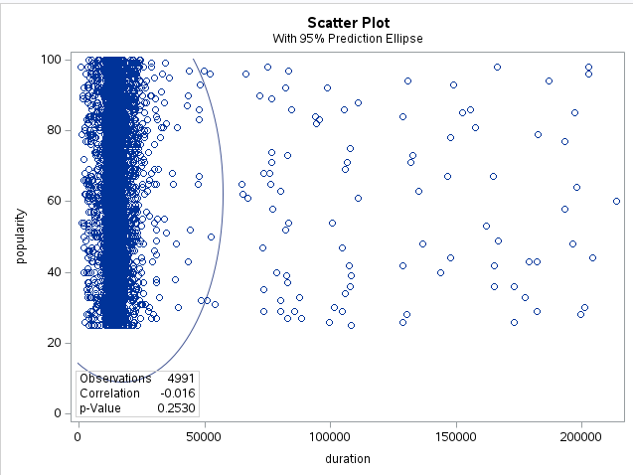
Whether there is a relationship between numeric variables?

Slide 7
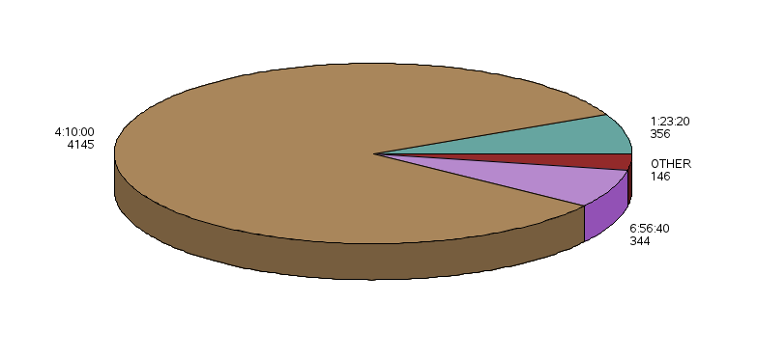
Analysis of the duration of the songs.

Slide 8
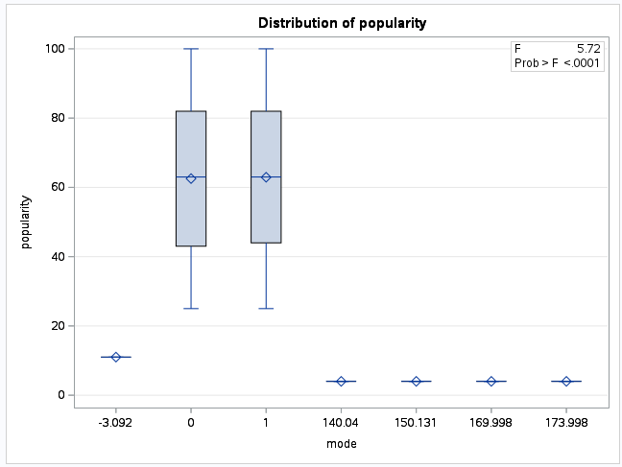
Whether there is a relation between mode and popularity of the song?

Slide 9
FUTURE SCOPE
Creator Platform
Personalization
Format Expansion
Ubiquity

Slide 10
CONCLUSION
We can say that, most of the songs are in the duration 4:10 mins.
There is an inter relation between all the numeric variables.
There is a relation between mode and popularity of the songs.

Slide 11
THANK YOU!

